Slide 1
Team Collaboration using Git and GitHub

Slide 2
Team Collaboration
Manage Team Members
Pull Requests
Bug Tracking
Graphs and network
Code Review (not done)
Documentation

Slide 3
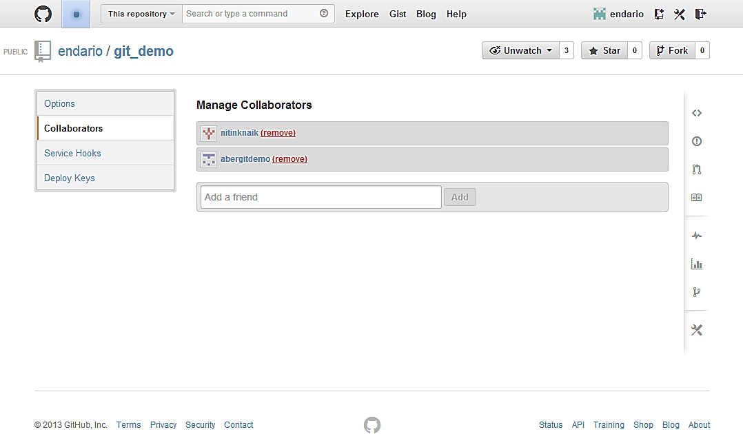
1. Manage Team Members
Settings > Collaborators > Add a friend

Slide 4
2. Pull Requests
Two types of collaborative models on GitHub
Fork & Pull Model
Used in a public repository for which we don’t have push access
Share Repository Model
Used in a private repository for which we have push access.
Fork is not required is this case.

Slide 5
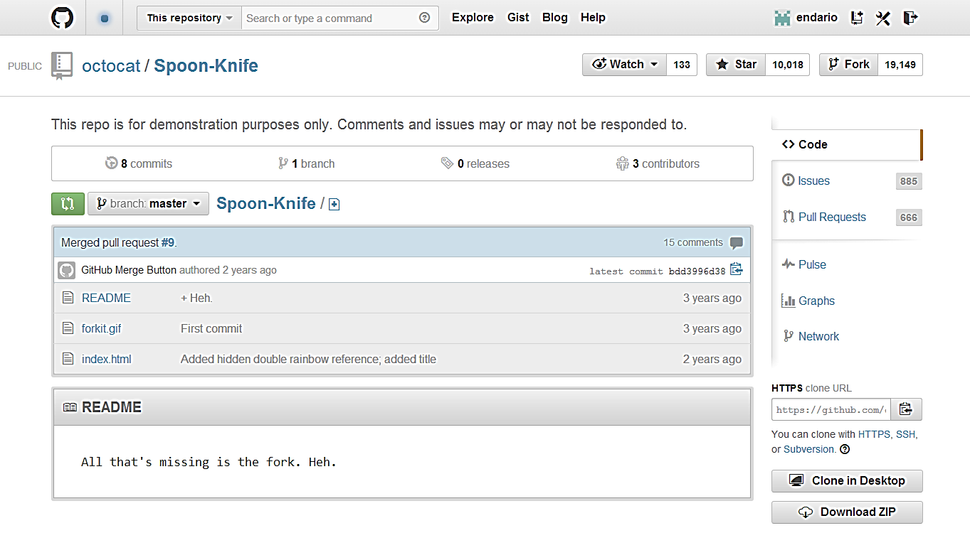
Fork A Repository
Forks are higher level ‘branches’ allowing isolated development on a collaborative project.

Slide 6
Clone a Fork and Configure Upstream
Clone your fork
Configure remotes
Pull in upstream changes
$ git clone https://github.com/endario/Spoon-Knife.git
Cloning into 'Spoon-Knife'...
remote: Counting objects: 24, done.
remote: Compressing objects: 100% (21/21), done.
remote: Total 24 (delta 7), reused 15 (delta 1)
Unpacking objects: 100% (24/24), done.
$ git remote add upstream https://github.com/octocat/Spoon-Knife.git
$ git fetch upstream
From https://github.com/octocat/Spoon-Knife
* [new branch] master -> upstream/master
$ git fetch upstream
# Fetches any new changes from the original repository
$ git merge upstream/master
# Merges any changes fetched into your working files

Slide 7
Modify Your Fork
Create branches
Push your commits
$ git checkout –b colour
Switched to a new branch ‘colour’
$ git commit -a -m 'modified index page with some colour and boldness'
[master d5a7377] modified index page with some colour and boldness
1 file changed, 7 insertions(+), 1 deletion(-)
$ git push origin colour
Username for 'https://github.com': endario
Password for 'https://endario@github.com':
Counting objects: 5, done.
Delta compression using up to 4 threads.
Compressing objects: 100% (3/3), done.
Writing objects: 100% (3/3), 396 bytes | 0 bytes/s, done.
Total 3 (delta 2), reused 0 (delta 0)
To https://github.com/endario/Spoon-Knife.git
bdd3996..d5a7377 colour -> colour

Slide 8
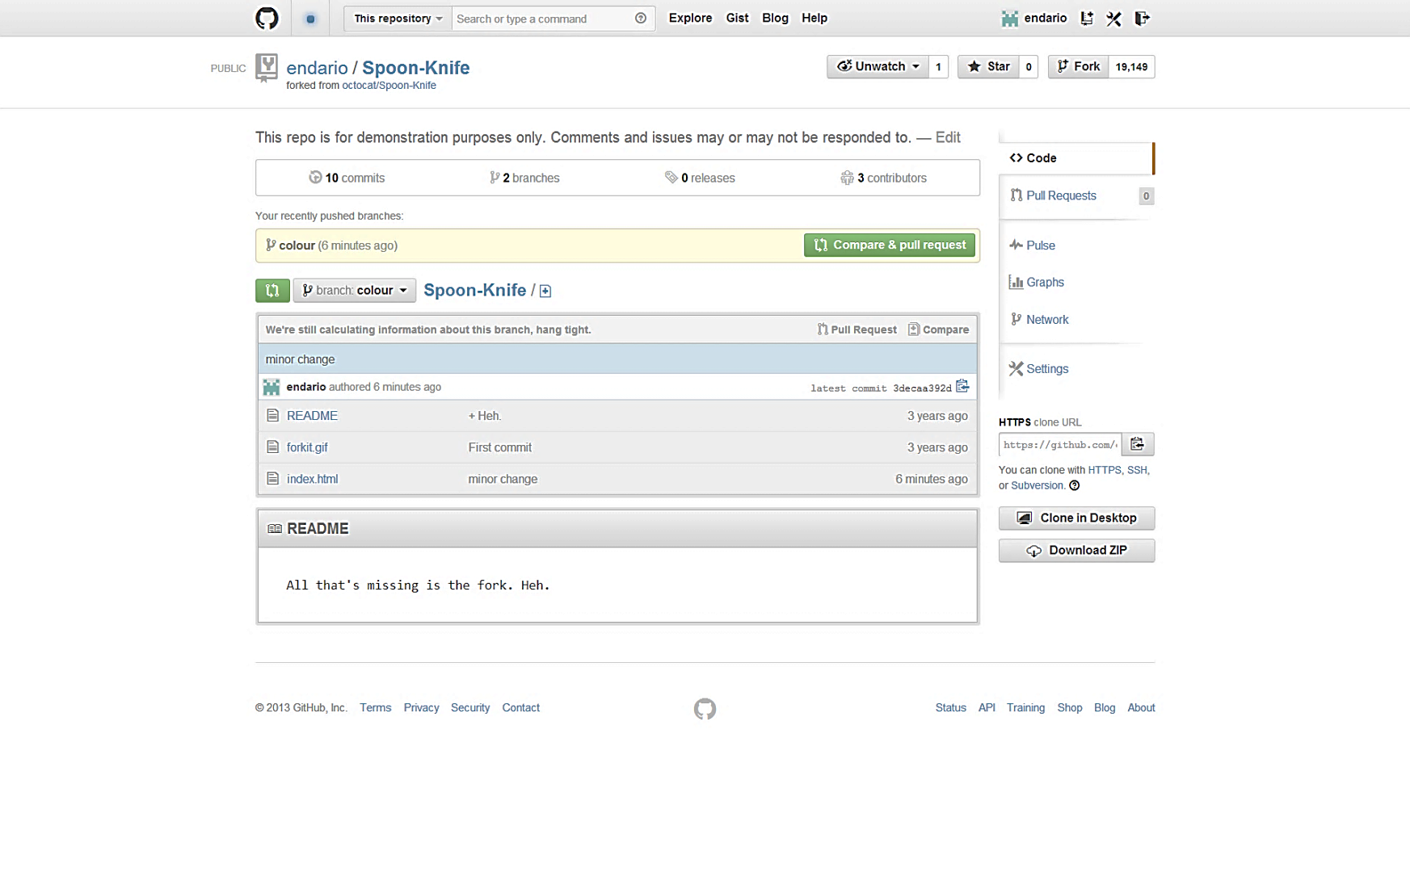
Initiate a Pull Request
Once you’ve made a few commits, you would like someone to review and merge. Navigate to your repository with the changes you want someone else to pull, and press the Pull Request button.

Slide 9
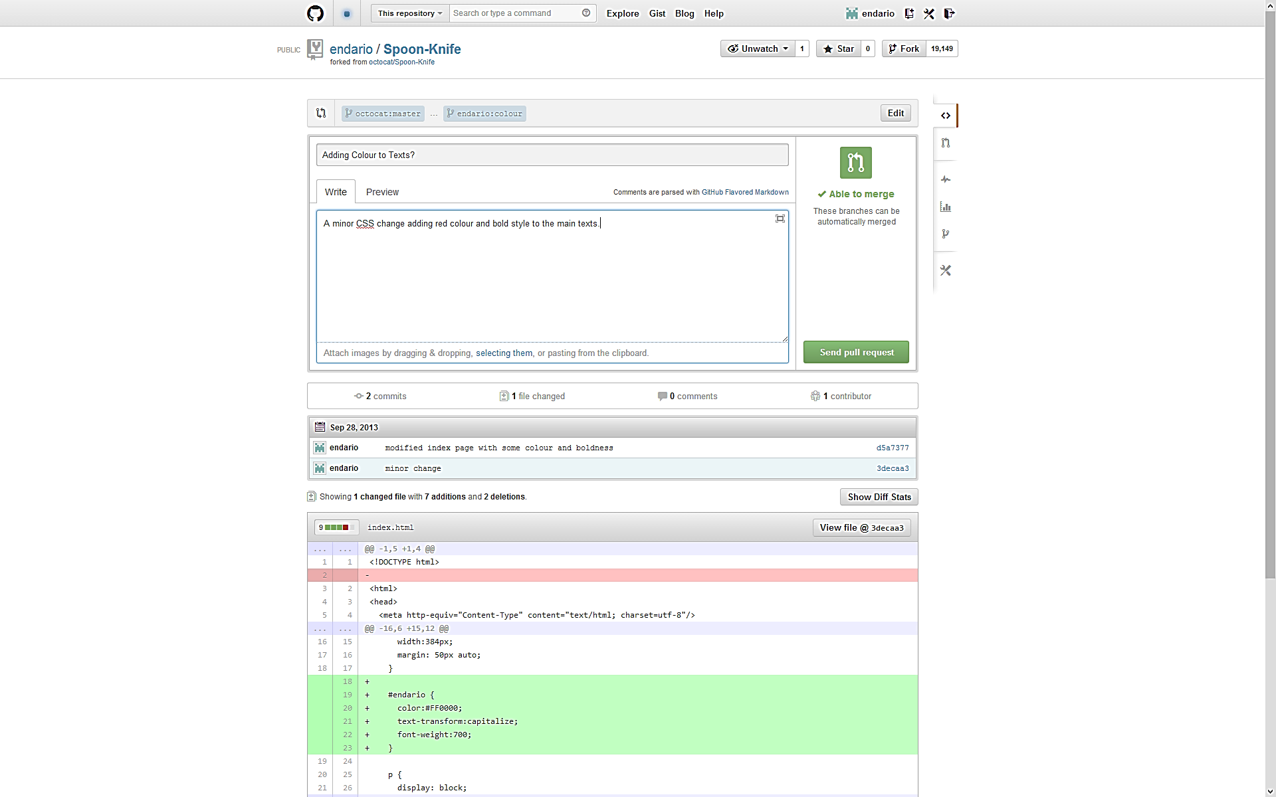
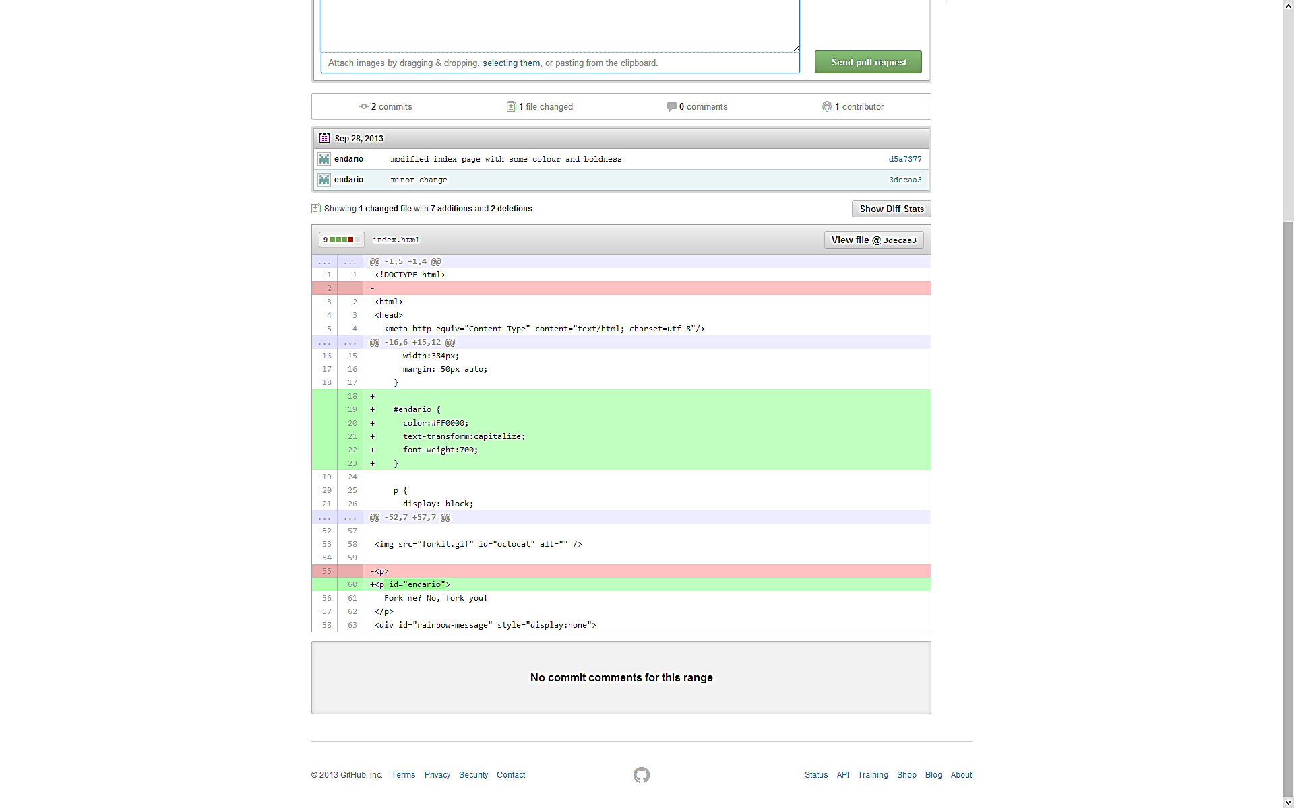
Review a Pull Request
You are then presented with a review page where you can get a high-level overview of what exactly has changed between your branch and the repository's master branch.

Slide 10
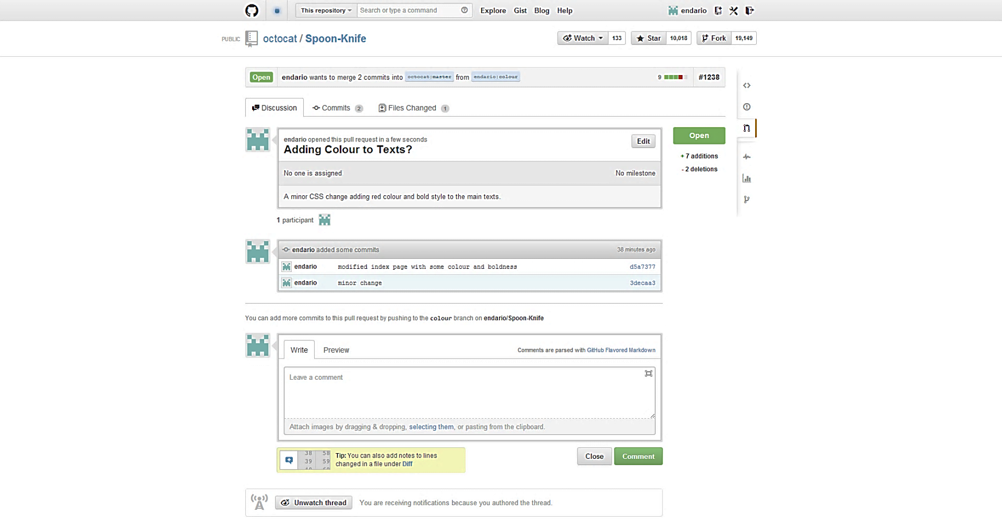
Send a Pull Request
You are then presented with a review page where you can get a high-level overview of what exactly has changed between your branch and the repository's master branch.

Slide 11
Share Repository Model
In principle, same as fork and pull
So long a different version is present to compare and initiate a pull request.

Slide 12
3. Bug Tracking
Bugs
Things that are obviously broken and need fixes
Features
Awesome cool new ideas to implement
To do list
A checklist of items to complete
Questions
Clarify misunderstandings

Slide 13
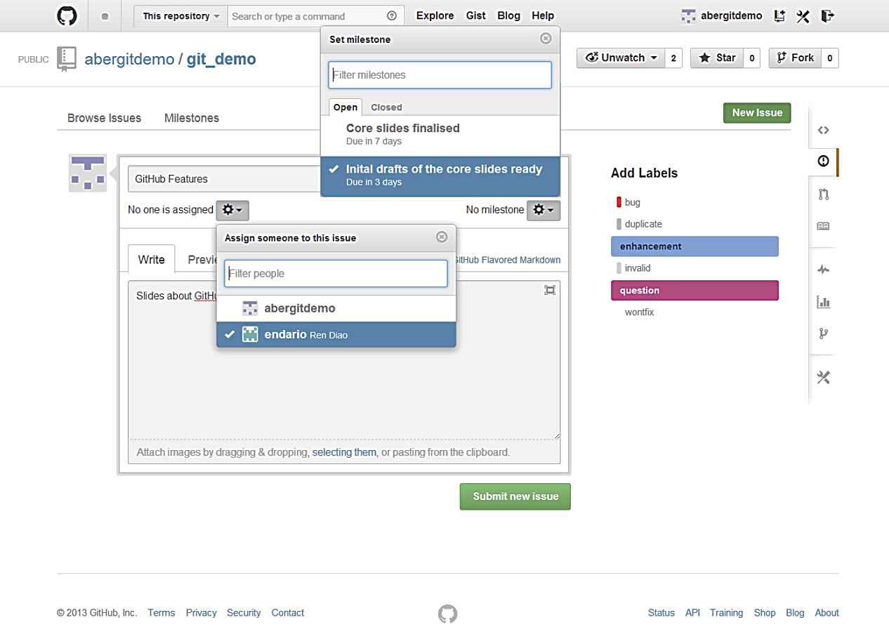
Open a New Issues
Milestone
Assignment
Labels
Notes:
Points to be made:
assign people
assign milestone (more later)
add labels (customisable)
people get email notifications so long being related to a given issue or @mentions.
you can mute the notifications

Slide 14
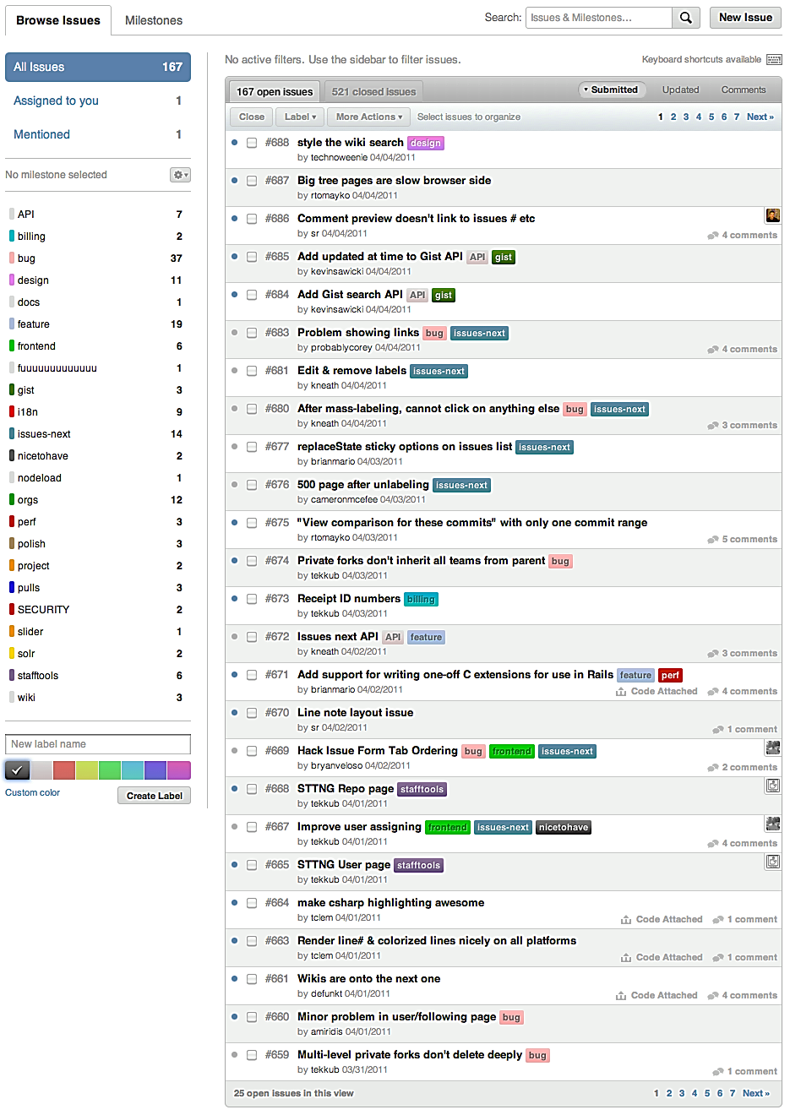
Navigating Issues
Search
Labels

Slide 15
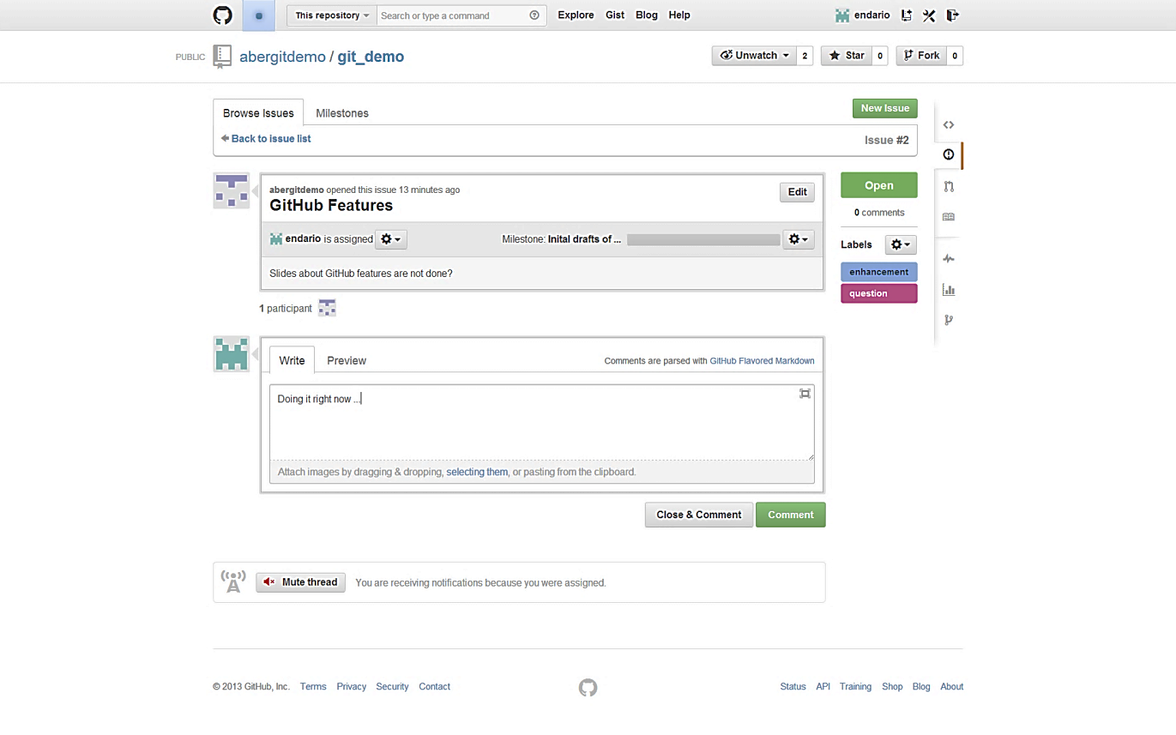
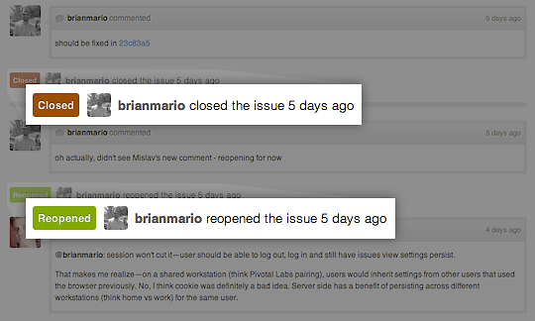
Closing & Re-Opening an Issue

Slide 16
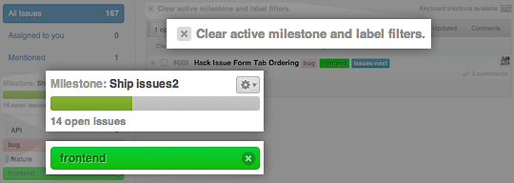
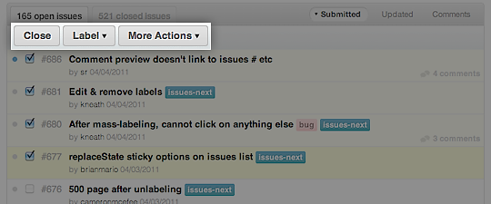
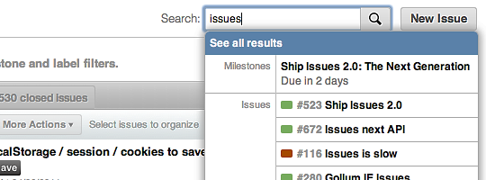
Working with Issues (1)
Filter by labels, milestones, etc.
Mass-editing: close, reopen, add labels, assign to users, etc.
Quick-search as you type, or open full search.

Slide 17
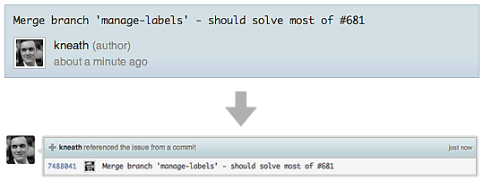
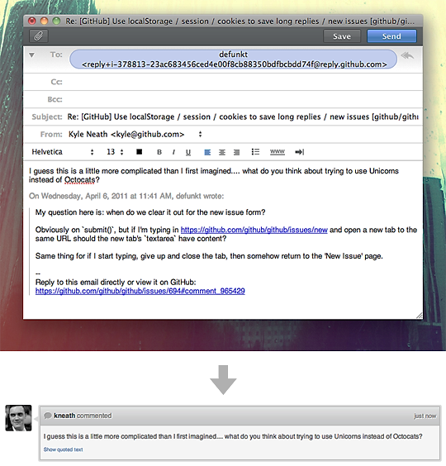
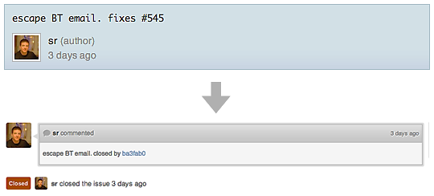
Working with Issues (2)
reference an issue from a commit message
close issue using commit
Reply by email

Slide 18
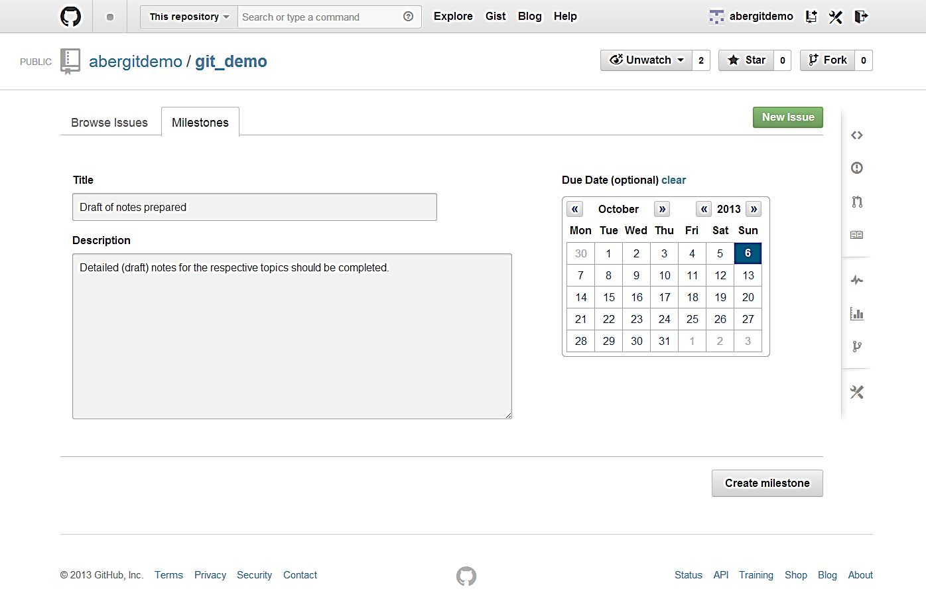
Create a New Milestone

Slide 19
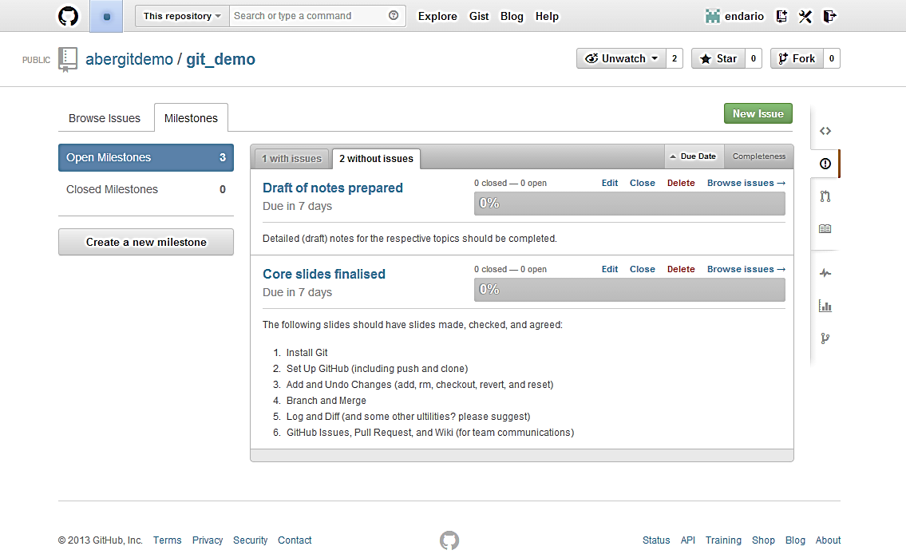
View Milestones

Slide 20
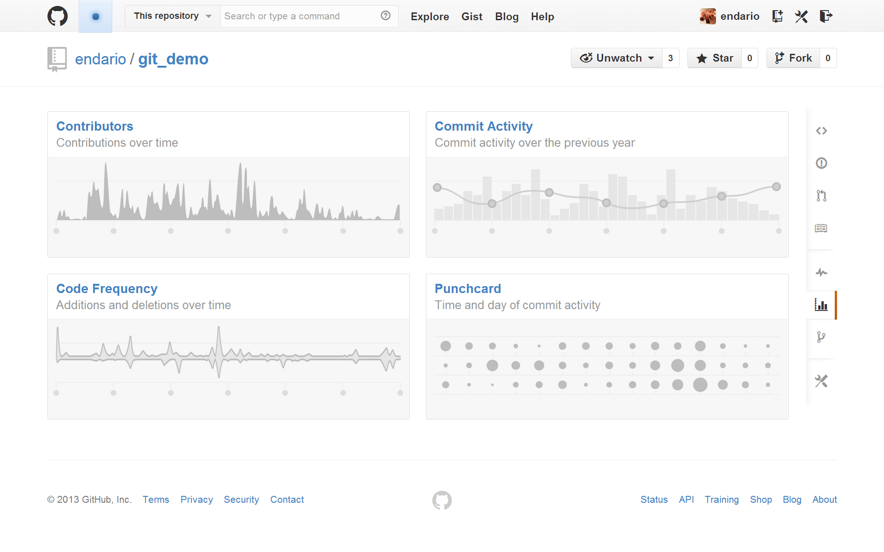
Graphs
GitHub Graphs provide insights into the collaborators and contributions behind each code repository.

Slide 21
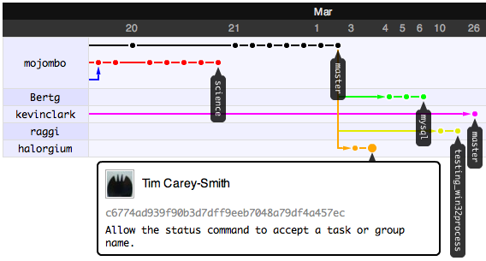
Network
GitHub Network provides a visualization on each contributors and their commits across all branches / forked repositories.

Slide 22
Code Review
Incomplete

Slide 23
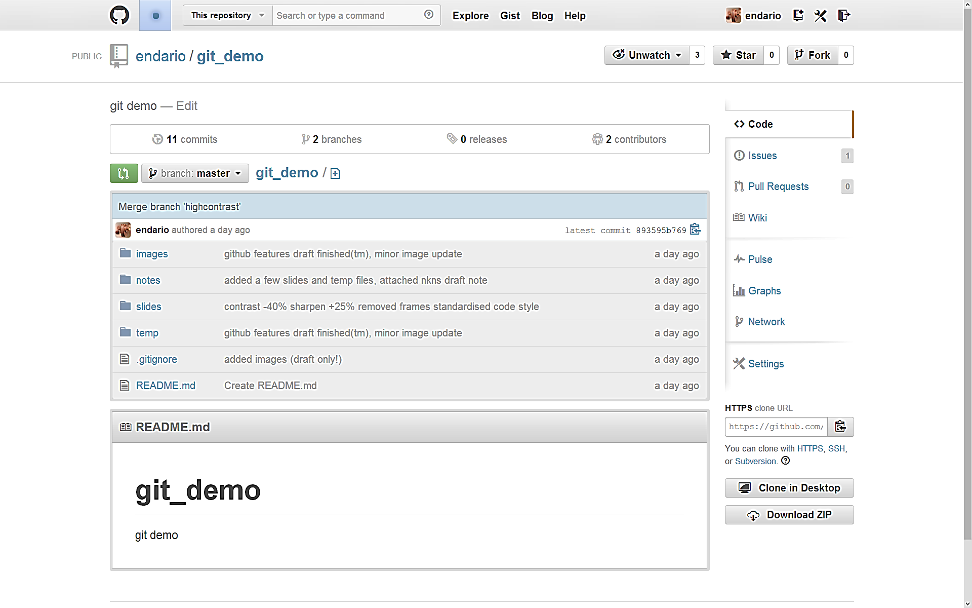
GitHub Wiki

Slide 24
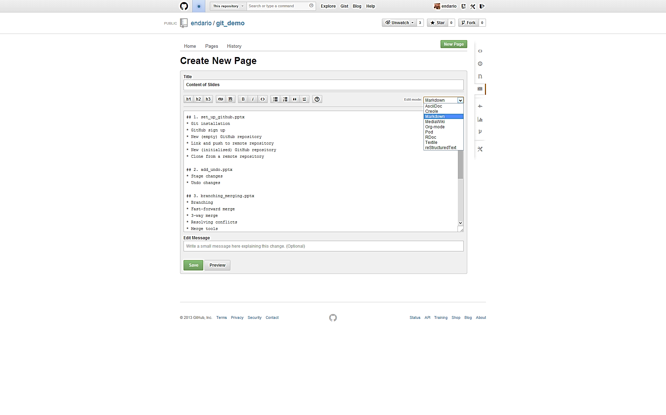
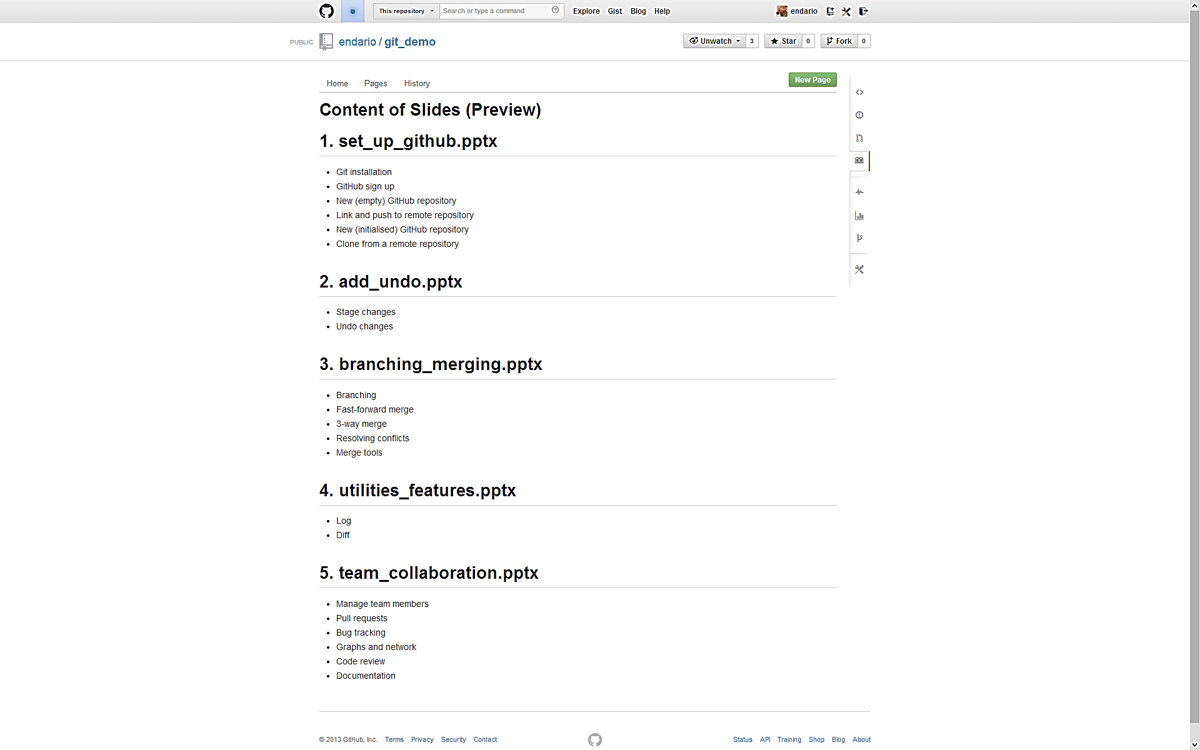
Edit and Preview New Wiki Page

Slide 25
Recommended Readings
http://net.tutsplus.com/articles/general/team-collaboration-with-github/
https://github.com/features/projects/

